Slide 1
GROUP 17
HOSTEL MANAGEMENT SYSTEM
MEMBERS:
RAHUL UDHAYAKUMAR
SANEEL TARE
PRADNYAL GANDHI
MAYANK MANSINGHKA
AKSHAY BARNE

Slide 2
OBJECTIVES
Hostel Management System aims at creating a centralised database to handle students, hostel and its related data efficiently. Different problems related to housing, catering can be addressed using an efficient database design providing solution to college management problems. The objectives of this project are mentioned below
Multiple students can stay in a single hostel managed by a Hostel Manager which falls under hostel management.
Students may have visitors in the hostel mapped to individual Students
Hostel provides a Billing facility for students who must pay fees for hostel services
Hostel provides Catering services for students which has its own set of catering employees
Catering service provides catering packages for students to select food packages
Catering handles the food packages, delivery of food in collaboration with Hostel Manager
Students can also provide Feedback to the Hostel Management for services

Slide 3
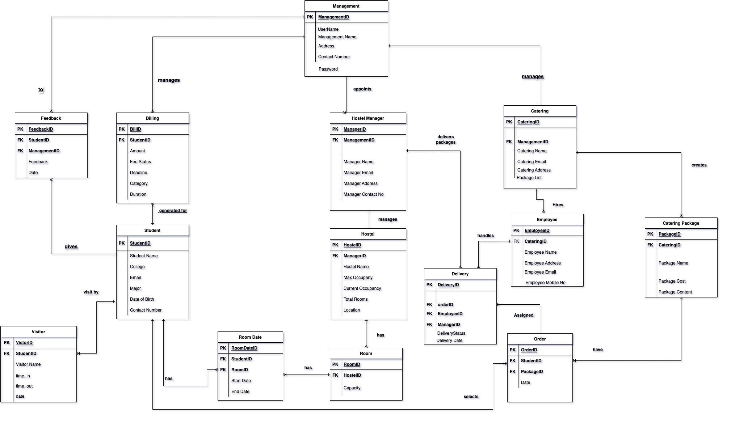
FINAL ERD

Slide 4
DDL OBJECTS
Employee
Works for Catering
Student
University Student
Billing
Fees and Food bill for student
Visitor
Guests who visit student in Hostel
Catering
Hostel approved Food service
Catering Package
Food package for student to choose from
Feedback
Student’s feedback to Management
Order
Food order from Student to Catering
Delivery
Food Delivery from Catering to Student
Management
University Hostel Management
Hostel
University Housing
Hostel Manager
Manager of Individual Hostel
Room
Individual Room in Hostel
Room Date
Duration of Individual occupied Hostel Room

Slide 5
STORED PROCEDURES
VIEWS
TRIGGERS
ENCRYPTION
Book Room
Books a Room for Individual Student in Hostel
Get Total type of Orders Not Delivered
Provides total number of Food Packages not delivered to Hostel
Insert Employee
Inserts new Catering Employee
Insert Management
Inserts New Management
Insert Student
Inserts New Student into Management
OrderDetails
Provides list of all Food Orders
Order Delivered
Returns all food orders that were delivered
Orders not Delivered
Returns food order that were not delivered
Insert Student
Student Details
Student Feedback
Update Student Mobile No
Management Password

Slide 6
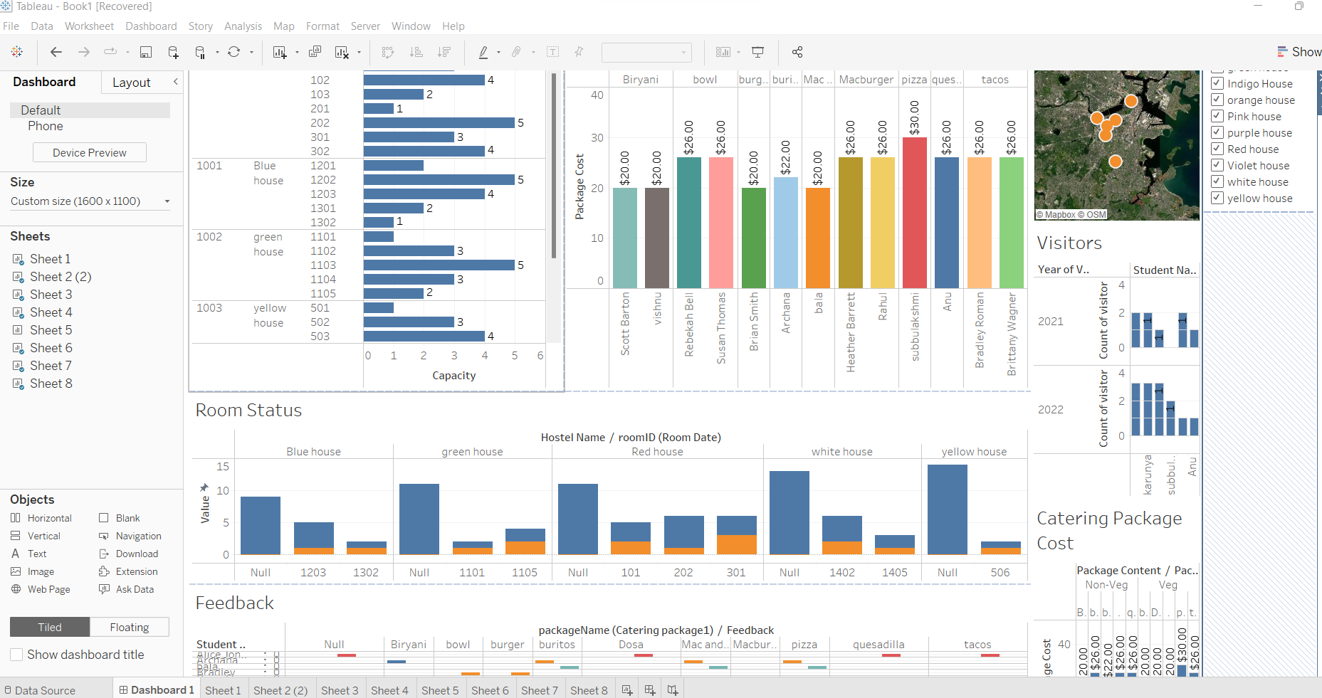
DATA VISUALIZATION WITH TABLEAU

Slide 7
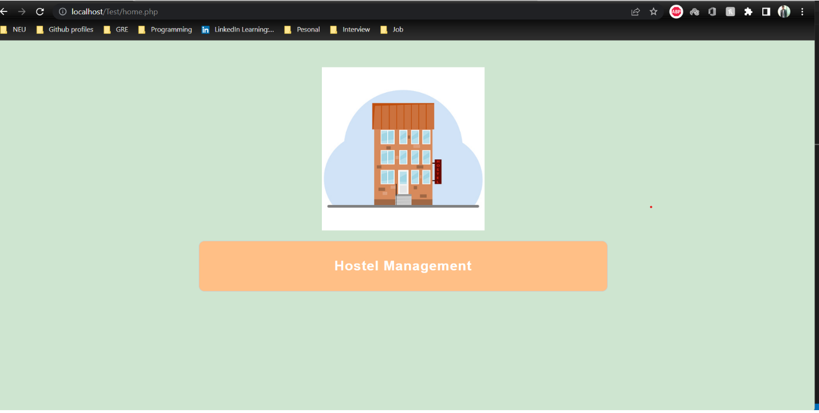
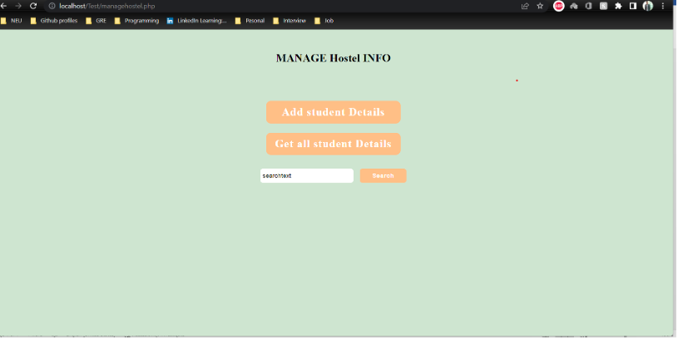
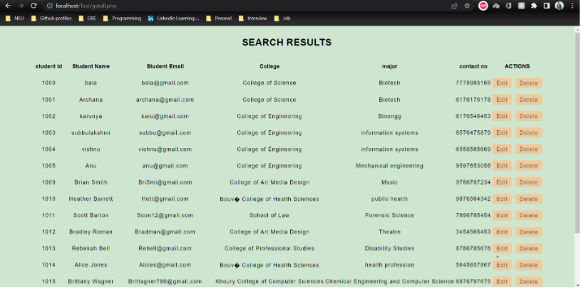
GRAPHICAL USER INTERFACE
Created in PHP
Has functionality to Add, Update, Delete and View Student Information
Search all students
CRUD based on ID

